Slide 1
The Social Capital Synthesis of Behavioral and Socio-economics
Lindon J. Robison
Michigan State University
(robison@msu.edu)

Slide 2
“Where we are depends on where we’ve been. Where we go depends on where we are now” (Adapted from Eliza R. Snow)
A Brief Review of Economic Thought

Slide 3
The Classical era (late 1700s to late 1880s)
An easy sharing of insights across the social sciences as they existed at that time. Adam Smith was a moral philosopher. J.S. Mill: “A person is not likely to be a good economist who is nothing else.” If there is a theme for this era it might be “laissez-faire" or "let it be.” (Swedborg)

Slide 4
Transition to neoclassical economics (1880s to 1910)
Transition from political economy and classical era to neoclassical economics. Carl Menger led an abstract marginalist approach that challenged the historical economic approach. Historical economics became a separate branch of economics. Alfred Marshall is the most important figure of this era with his “Principles of Economic” first published in 1890—8 more editions followed.

Slide 5
Economic isolation (1920s-1960).
Economics comes into its own and is mathematized. Illustrative of this era was Paul Samuelson’s “Foundation of Economics”.

Slide 6
Economic imperialism (1970---)
Era of economic imperialism and redrawing social science boundaries: “the economic approach is applicable to all human behavior” (Gary Becker 1976. p. 8). Economics began to address problems that were previous the domain of other social sciences: family, education, crime, urban development, crime, etc.

Slide 7
The Social Science Push back (began earlier but became popular in 1980s--)
Assumptions are unrealistic.
Evidence of predictably irrational behavior “Misbehaving” experiments.

Slide 8
Neoclassical Model Assumptions
People have rational and fixed preferences that can be defined over choice outcomes and goals.
People maximize (optimize) the utility (usefulness) over the different goods and services they purchase subject to constraints and maximize the profits of firms they direct (i.e. people are selfish).
People act independently on the basis of full and relevant information (E. Roy Weintraub).
People follow the rules and transactions are costless.
Markets are separate from society--people influence each other through markets.

Slide 9
Some evidence supports the criticisms of the neoclassical economics model assumptions as unrealistic
The evidence is:
We are not 95% selfish (Robison, Shupp, Jin, Siles)
We are not always rational (Herbert Simons)
We are not fully informed nor always consider the information we have available.
Preferences not fixed.

Slide 10
Examples of “predictably irrational choices” where behavior is not consistent with the neoclassical model predictions.
Endowment effects (Cornell Coffee Mugs)
Framing effects (10% fat versus 90% fat free—emotional response to words)
Anchoring effects (this is the way we’ve always done it.
Risk avoidance (asymmetric response to gains and losses)
Ikea results (I invested myself in its creation)
Expected utility paradoxes (Allais and Ellsberg)
New books such as “Misbehaving” and “Predictably Irrational” have produced catalogues of choices inconsistent with neoclassical predictions.

Slide 11
Socio-economic origins of push back
Originating mostly in sociology (Etzioni, Swedborg)
Socio-economics deals with the analytical, political and moral questions arising at the intersection between economy and society from a broad interdisciplinary perspective with links among sociology, political economy, moral philosophy, institutional economics, and history.
Individuals are influenced by norms and values held by members of their networks. Focus is on “We”
Main criticism is that markets and society cannot be separated and individuals are influence by others—we do not act independently of other.

Slide 12
Origins of behavioral economics push back
Studies the effects of psychological, social, cognitive and emotional factors affecting economic choices of individuals.
Leaders of behavioral economics include psychologists Amos Tversky and Daniel Kahneman, Dan Ariely, and later joined by economist Richard Thaler.
They challenged the assumptions underlying neoclassical economics
Agents are not perfect selfish
They lack perfect will-power.
They are not fully informed
Thaler: “they are nicer and dumber” than agents described in neoclassical models
Focus on the individual—the “I” approach

Slide 13
Criticisms of the Socio-economic and Behavioral Economic Pushback
It appears to be a piece meal approach to solving the failures of the neoclassical model.
It has no unifying paradigm like the one offered by neoclassical economics
It really hasn’t explained why the neoclassical model works well under some circumstances.
The pushback presents a conflict between “I” versus “We” assumptions: individual agents with freedom to choose versus agents directed and influenced by the social solidarity of their networks.

Slide 14
In defense of the neoclassical model assumptions
Assumptions don’t need to be realistic (models are never realistic) as long as they predict.
Sometimes we do act like “Econs”
Sometimes we are selfish
Sometimes we are rational in bounded choice environments
Sometimes we do process available information (Thinking slow and fast.)
Sometimes the economic models do explain choices and predict future events (Otherwise economists would be unemployed).
Must not confuse micro and macro economic model failures.

Slide 15
The Reintegration of Economics and the social sciences
The trend is toward a reintegration of economics with the social sciences.
Recent Nobel prizes in economics have been awarded to a political scientist (Ostrom), a psychologist (Kahneman), and a behavioral economist (Thaler).
Experimental methods of the social sciences are increasingly being adopted by economists—note the number of papers based on experimental methods presented at most recent AAEA meetings.

Slide 16
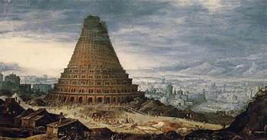
The Social Capital Paradigm
A personal Story
Tower of Babel

Slide 17
The social capital paradigm is an attempt to integrate economics and social science insights
The social capital interest group
Michigan State faculty organized the first international conference on social capital.
Participants at the conference were surveyed and found no consensus on the definition.
Some argued that social capital wasn’t really capital.
Confronting the definitional challenges: “Is Social Capital Really Capital” (Robison, Schmid, and Siles)
The social capital paradigm: a synthesis (Robison and Flora)
A summary: “Relationship Economics: The Social Capital Paradigm and its Application to Business, Politics, and other Transactions” (Robison and Ritchie)

Slide 18
Social capital paradigm: people optimize
Social capital is the sympathy (empathy), regard, trust one person has for another person or group.
Three kinds of social capital include:
Person i’s sympathy or esteem for self is called own social capital is called self esteem social capital ($K_{ii})$
Person i’s sympathy, trust, and regard for person j ${(K}_{ij})$ is called belonging social capital.
Person j’s social capital for person i perceived by i $\left(K_{ji}^{i}\right)$is called good-will social capital
Social capital lives in networks connected by their social capital.
Persons in Networks that possess symmetric and earned weak ties are said to have linking social capital
Persons in Networks with inherited and strong ties are said to have bonding social capital
Persons in networks that possess asymmetric ties are said to possess bridging social capital

Slide 19
The Social Capital Optimizing model
Maximize $U_{i}(commodities, relational goods)$
s.t. $\sum{x}≤b$ where b is a combination of physical and social resources and x represents investment of resources in commodities and SEG producing social capital
production function for commodities for persons i and j$: π_{i}(x)$ and $π_{j}(x)$
Agent i’s relational good production function:
$$relational goods=g[π_{i}\left(x\right),K_{ii}\left(x\right),K_{ij}\left(x\right),K_{ji}^{i}\left(x\right),π_{j}\left(x\right)]$$
Indirect utility function:
Max $U_{i}[π_{i}(x),K_{ii}(x),K_{ij}(x),K_{ij}^{i} (x),π_{j}(x)]$
s.t. $\sum{x}≤b$

Slide 20
Motives derived from optimizing the social capital model’s objective function
$π_{i}:own consumption$ (selfishness of preference)
$K_{ii}:promise keepers$ (internal validation)
$K_{ij}:belonging$ (connections)
$K_{ji}:good will$ (external validation)
$π_{j}:sharing$ (sympathy)
Reference: L.J. Robison et al. (2012). “The relative importance of selfishness and social capital motives.” The Journal of Socio-Economics 41 (2012) 118– 127

Slide 21
Social capital paradigm: relational goods and commodities
Social capital produces an important class of goods, relational goods. Two types of relational goods:
intangible socio-emotional goods.
Mostly tangible goods embedded with intangible socio-emotional goods.
Relational goods produced in social capital rich relationships.

Slide 22
Social capital paradigm: Relational goods and commodities (contd.)
Relational goods
Value depends at least in part on their connections to people who produce, exchange, consume, and preserve them.
Relation goods mostly ignored in the standard economic model
Commodities
Value depends mostly on their physical properties.
The production, marketing, and consumption of commodities is the focus of traditional economics.

Slide 23
Relational goods and commodities satisfy different needs
Goods must satisfy needs or they are not goods.
Commodities satisfy mostly physical needs and sometimes to win socio-emotional goods but not very successfully.
Relational goods satisfy socio-emotional needs
Need to belong (love, friendship, connections)
Need for internal validation by our ideal self (self-actualization, self esteem)
Need for external validation from others for whom we have regard, empathy, sympathy, trust (good will of others)
Need for knowledge that contributes to ones sense of belonging, and internal and external validation

Slide 24
Table 1. Properties of commodities and relational goods.
Property | Commodities | Relational goods
1. Exchange setting. | Impersonal setting in which buyer and seller are not known to each other.. | Personalized setting in which buyer and seller are connected through a social relationship.
2. How terms and level are exchange are determined. | Terms and level of goods exchanged are determined by the aggregate influence of market participants. | Terms and level of goods exchanged are uniquely determined by persons engaged in the exchange.
3. Substitutability of goods. | Standardized goods with uniform quality which allows one commodity to substitute for another. | Relational goods are unique with few substitutes because their value is determined by the social capital of those involved in its exchange.
4. Value determining properties. | Mostly observable, physical properties. | Mostly unobservable intangible SEGs exchanged directly or embedded in an AVG.
5. Capital used in their production. | Manufactured, natural, human, and financial capital may all be important in the production of commodities. | Social capital is required in the production of relational goods.
6. How the value of the good is changed. | Value is altered by changing the physical properties of the good including its form, function, location, taste, color, and other physical properties. | Value is altered by humanistic acts that produce SEGs which may lead to increased investments in social capital or which may become embedded objects creating AVGs.
7. Needs satisfied. | Mostly physical | Mostly socio-emotional
8. Durability. | Mostly nondurable or used infrequently. | Mostly durable or if nondurable, used frequently.
9. Certification. | Arm’s length agencies empowered with regulatory and inspection duties. | Within the relationships associated with the good’s production, consumption, or exchange.

Slide 25
Implications of the social capital paradigm
Exchanges that include relational goods will produce terms and level of exchange different than those predicted by the neoclassical model with its focus on strangers exchanging commodities.
Other things being equal, friends and family are more likely to conduct exchanges than strangers.
Commodity transfer centered organization (including governments) are not equipped to direct exchanges of relational goods—better performed by nongovernment organizations.

Slide 26
Hypothesis: Some economic exchange anomalies can be explained by accounting for relational goods—a missing variable
Think of buying an airline ticket with money and frequent flyer points.
Observing only the transfer of money would lead to an inaccurate description of the airline purchase.
Even after accounting for relational goods, we are sometimes--well---irrational.
We don’t compare costs and benefits accurately—think fast rather than slow
We let proximity and other related factors cloud our judgement.

Slide 27
Isoquants and economic exchange anomalies

Slide 28
An Example: Farmland market Anomalies

Slide 29
Anomalies in the used car market Minimum sell price for a used car with a market value of $3,000 (n=600)
 | Nasty Neighbor | Stranger | Friend | Family
Above $3750 | 65
$3,500-$3750 | 263 | 39 | 2
$3,250-$3500 | 21 | 33 | 5 | 1
$2,750-$3250 | 236 | 476 | 122 | 29
$2,750-$2,500 | 11 | 30 | 135 | 24
$2,500-$2,250 | 4 | 22 | 298 | 199
Below $2,250 |  |  | 38 | 348

Slide 30
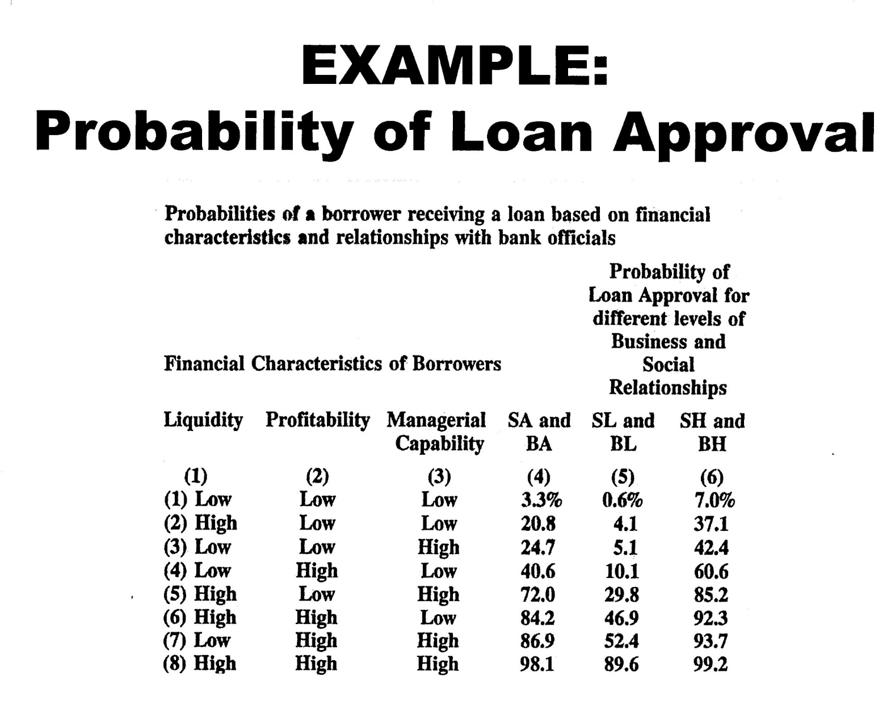

Slide 31
Implication of the social capital paradigm: We are not 95% selfish

Slide 32
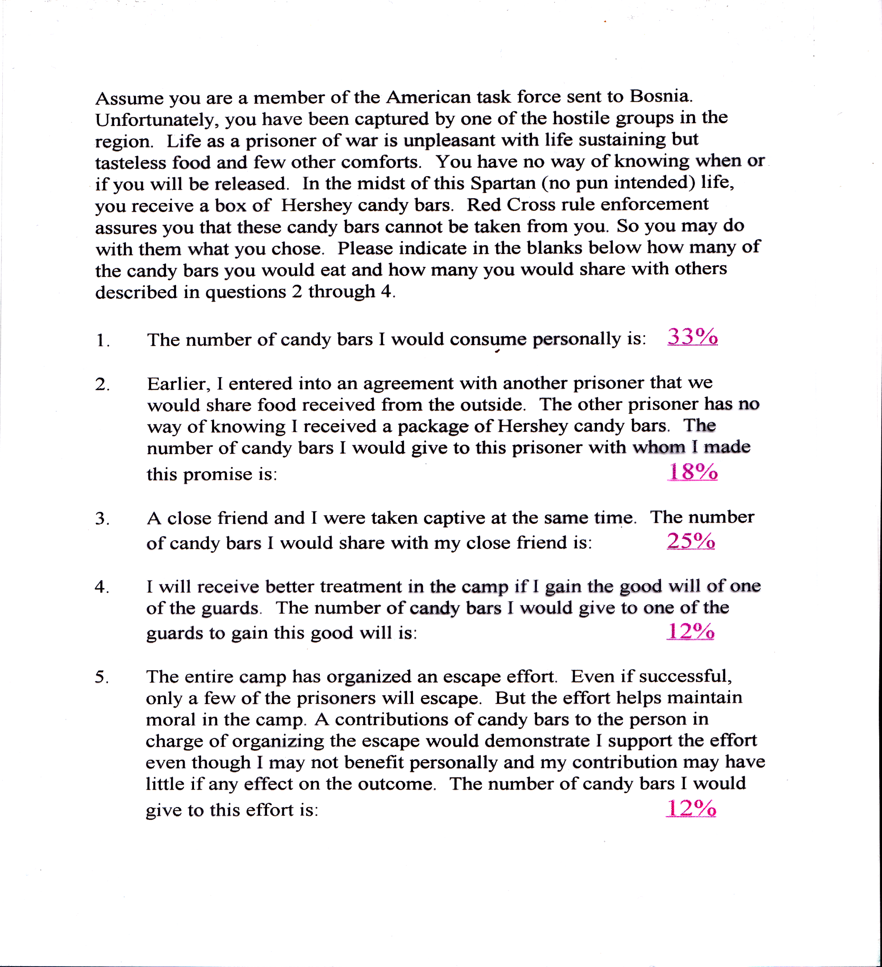

Slide 33
A motives experiment
Groups were approached and individuals were offered a cash reward if their name were randomly drawn. They were asked how they wanted their reward distributed if their name was drawn and they won the prize? Their options included:
-Keep the money for themselves. (own consumptions motive)
-Share the money with a named friend. (sharing motive)
-Donate the money to a charity they promised to support. (self respect motive)
-Donate the money to a the club or group to which they belonged. (belonging motive)

Slide 34
The social capital paradigm: the relative importance of motives vary by group.
Dollar prizes of $300 dollars were allocated as follows:
Rotary Club members allocated 91% of their rewards to social capital related motives.
Dairy club members allocated 67% .
International students allocated 76%.
A professional business group allocated 84%.
Students at Northern Michigan University allocated 45%.

Slide 35
Implications of the social capital paradigm: There is a social production process that changes the value and meaning of goods. Involves connecting things to people.
Honorific acts
Commitment acts
IKEA acts
Anthropomorphizing acts
Ownership (endowment) acts
Association acts
Follow the leader acts
Common kernel identification acts
Gifting acts
Talking about

Slide 36
Honorific Acts that satisfy the need for External validation and attachment value for symbols (trophies, plaques, certificates)
Description of act | Social capital and objects affected | Examples of act
Person j’s recognizes person i’s noteworthy achievements, especially in a public setting. | Objects associated signaling the honor may become an AVG. Person receiving the honor receives external validating SEGs. May affect all three forms of social capital | Ceremonies recognizing persons in a public setting for exceptional achievements in academics, athletics, music, theatre, sales, etc. Ceremonies may also include the presentation of AVGs such as trophies, certificates, or commodity gifts).

Slide 37
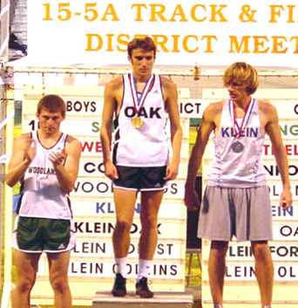
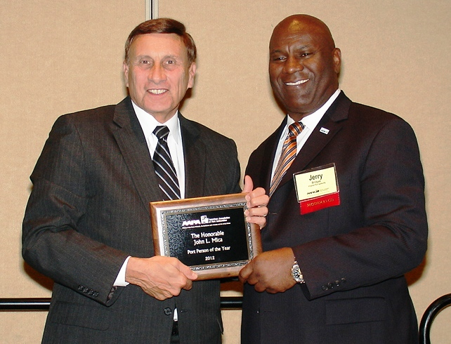
Honorific acts

Slide 38
Commitment Acts that satisfy the need to belong and attachment value for objects associated with commitment (wedding rings, organization symbols)
Description of act | Social capital and objects affected | Examples of act
Persons j and i make commitments and promises to each other | Objects associated with acts of commitment may acquire attachment value. Investments are made in belonging social capital.. | Ceremonies or exchanges in which commitments are made to each other or to an organization to which both parties belong (e.g. initiation or induction ceremonies, marriage commitments, commitments to a common cause as might occur when joining a team.

Slide 39
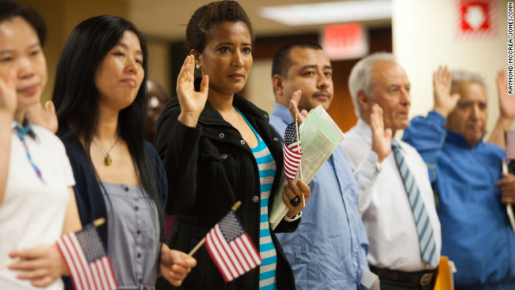
Commitment acts

Slide 40
Ikea Acts that satisfy the need for internal validation and attachment value for the object that was self-assembled or produced
Description of act | Social capital affected | Examples of act
A persons defines an achievement that is evidence of his or her capacity to achieve one’s goal and do hard things—and then achieves the task. | Internally validating SEGs may get embed in object and create an AVG and in one’s own social capital $\left(K_{ii}\right).$ | A person buys an unassembled piece of furniture from Ikea and assembles it successfully. One has a goal to run a marathon and achieves the goal. The achievement standard for an Ikea act is accepted or determine by person i.

Slide 41
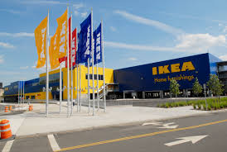
IKEA acts
Dan Ariely: Professor of psychology and behavioral economics at Duke and the founder of The Center for Advanced Hindsight and the IKEA effect.

Slide 42
Anthropomorphizing Acts that satisfy the need to belong and attachment value for the anthropomorphized good (animals, cars, a soccer ball)
Description of act | Social capital affected | Examples of act
Act that embed SEGs in objects in a way that endows them with human qualities capable of emotions and relationships. | Endowing an object with humanlike qualities creates an AVG which in turn produce investments in belonging social capital person i has for object j ($K_{i,j})$ | In the movie “Cast Away”, the main character played by Tom Hanks while on an uninhabited island anthropomorphizes a Wilson soccer ball which Hank’s character allows himself to imagine has humanistic qualities. Other acts include naming one’s car, pets, and other inanimate objects.

Slide 43
Cash Away and Wilson: creating relational goods by humanizing objects

Slide 44
The endowment effect
Ownership acts (the endowment effect) that satisfy the need to belong and create attachment value for the owned object (stocks, bonds, and coffee mugs)
Description of act | Social capital affected | Examples of act
Acts that associate a person with an object including physical objects, organizations, songs, places, and ideas. | Objects are embedded with SEGs which in turn produce AVGs which in turn may produce investments in belonging social capital person i has for object j ($K_{i,j})$ | Act made famous by an experiment in which person’s expressed value of the mug increased with the person’s ownership and association association with the mug. Describes car salesperson’s efforts to embed their cars with customers SEGs by having their customers test drive or at least sit in and touch the car.

Slide 45
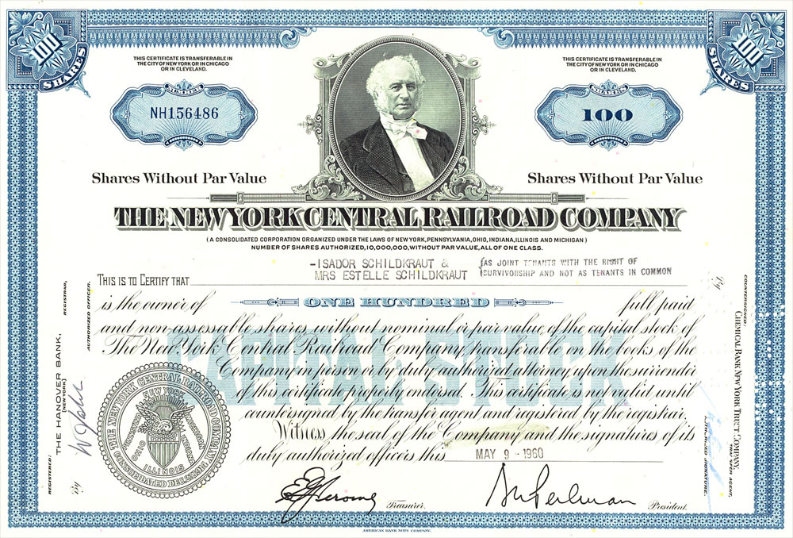
Cornell coffee mug and my favorite stock (even though it’s a loser)

Slide 46
Association acts that satisfy one’s need to belong and create attachment value for the object that connects one to social capital source (picture of famous person, baseball, or organization.
Description of act | Social capital affected | Examples of act
Acts in which an object is associated with a high social capital person or high attachment value good. | Objects are embedded with SEGs by their association with high social capital person, creating AVGs which increases the value of the object. | Well known marketing strategies in which famous persons and groups encourage persons to acquire their products.

Slide 47
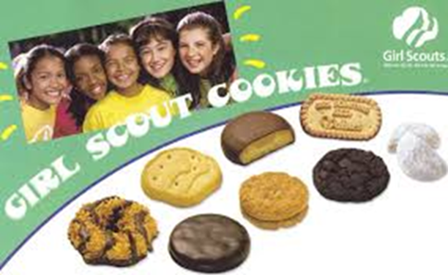
Kobe Bryant and Girl Scout Cookies

Slide 48
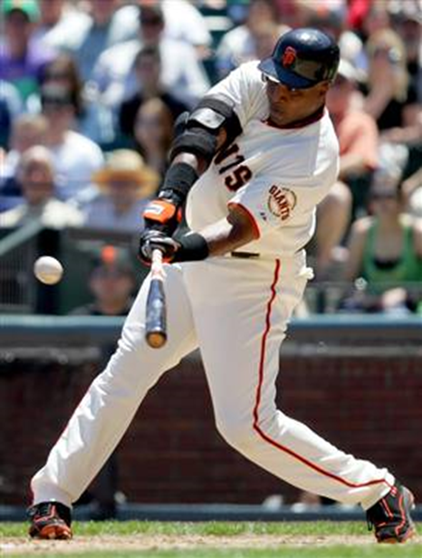
Barry Bonds and baseball
Baseballs are commodities.
When Barry Bonds hit a baseball for a record setting home run, he humanized it—he moved it from the commodity sphere to the humanity sphere.
The hit baseball’s meaning and value was changed as a result of the Barry Bonds’ humanizing act (at least for those who had regard for Bond).

Slide 49
Follow the Leader Acts that satisfy one’s need for external validation and belonging and creates attachment value for objects associated with the leader (particular item of clothing, color, song)
Description of act | Social capital affected | Examples of act
Acts in which person i attempts to duplicate the acts of person(s) j that appear to be widely accepted at the time. | By acquiring the object embedded with flows of relational goods, a person attempts to increase belonging social capital | Conforming to the actions of others by buying brand name objects because they are associated with famous persons or objects of high attachment value. Following investment trends.

Slide 50
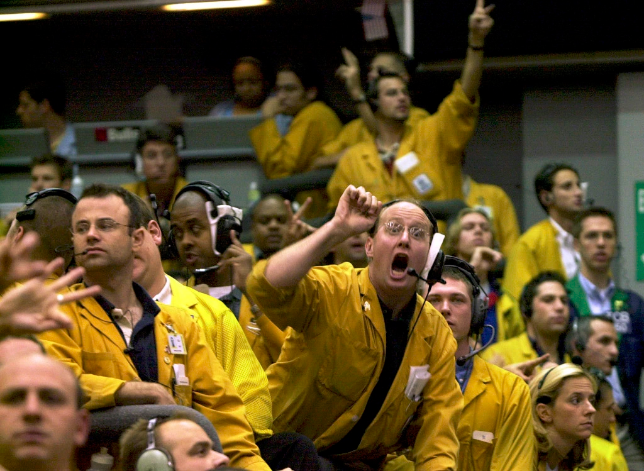
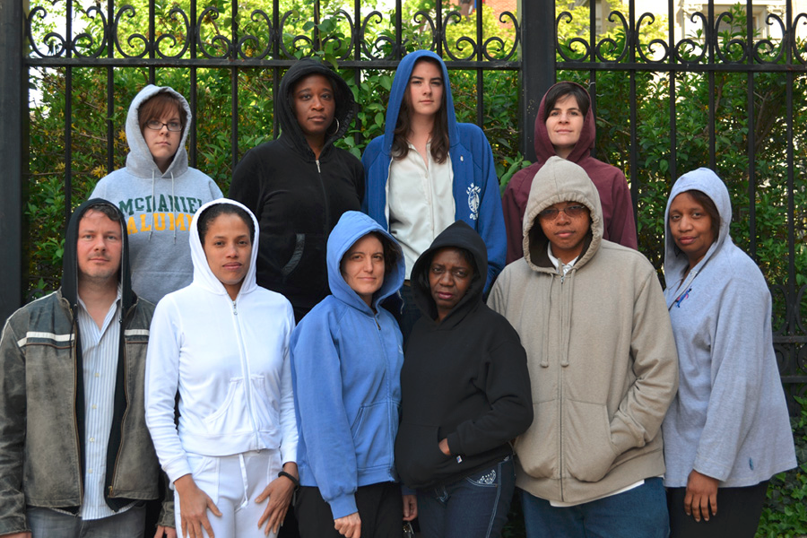
Follow the leader: fashions and investment bubbles

Slide 51
Acts that Identify shared traits and experiences that satisfy the need for belonging and external validation and produce attachment value for shared trait (home town, school symbol, produce validating and belonging SEGs
Description of act | Social capital affected | Examples of act
Acts in which persons $i$ and j attempts to discover commonalities that may form the basis of social capital investments. | Finding shared kernels or traits validate one’s own traits increasing one’s own social capital and increases one’s sense of belonging and good will social capital. | Identification acts may involve searching for persons with commonalities. Means for such searches may include sites or joining organizations when members share commonalities. Commonalities may include age, gender, political views, religion, schooling or social experiences.

Slide 52
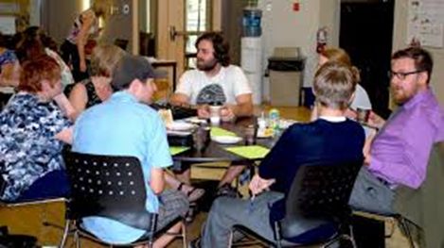
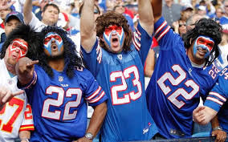
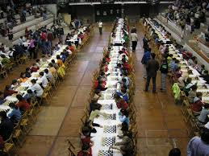
Finding common kernels

Slide 53
Nonmarket exchange acts (gifting) that produce external validating SEGs and may increase attachment value for persons associated with gift or attachment value for the provider of the gift
Description of act | Social capital affected | Examples of act
Acts in which persons $i$ offers to person j an object on subsidized terms. | By offering an object for a subsidized commodity price, the effort attempts to produce external validating SEGs that earn the good will social capital of others. | Selling farmland at below market prices. Businesses offering customers free goods and services.

Slide 54
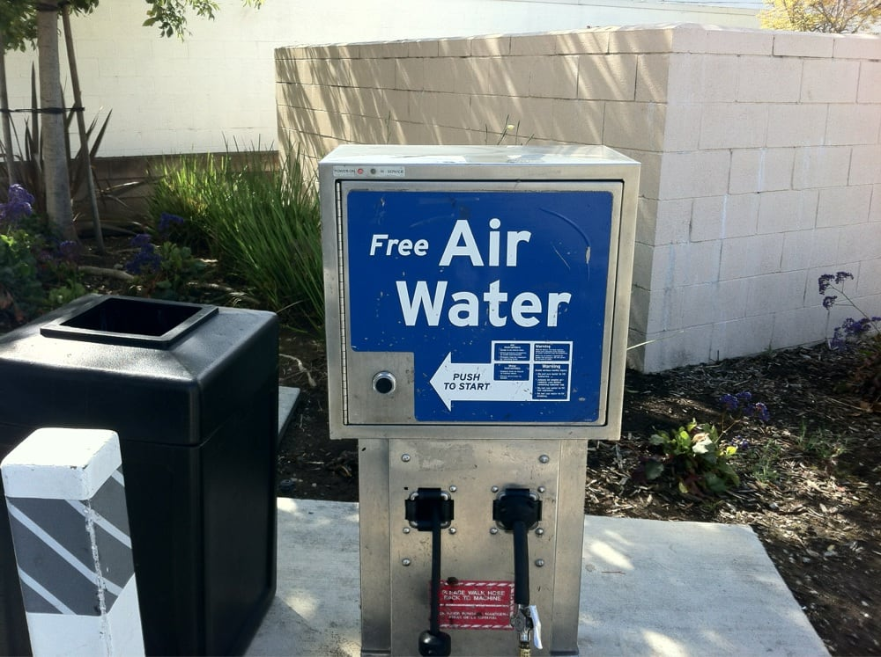
Examples of investing in social capital through exchanges on nonmarket terms

Slide 55
Implication of social capital paradigm: Distribution of social capital is directly related to the distribution of income.

Slide 56
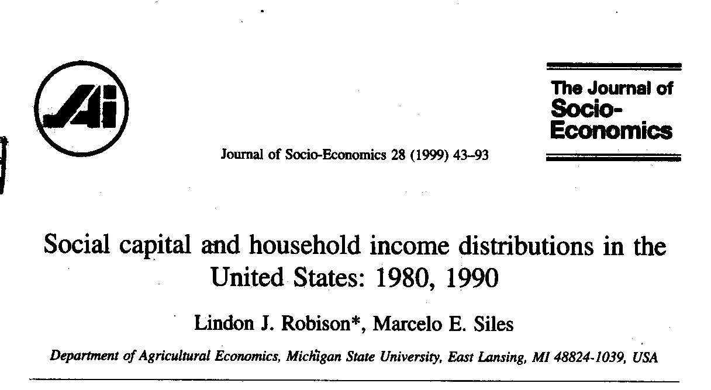
The Connection Between Social Capital and Distributions of Income

Slide 57
Implications of social capital paradigm: Corruption is a social capital distribution issue
Institutions are rules embedded with relational goods
Formal institutions require linking social capital
Informal institutions depend on bonding social capital
Formal and informal institutions complete for power
Corruption is informal institutions substituting for formal ones
Can be a good thing if formal institutions are inefficient or unjust
Can be a bad thing if they reduce opportunities to specialized

Slide 58
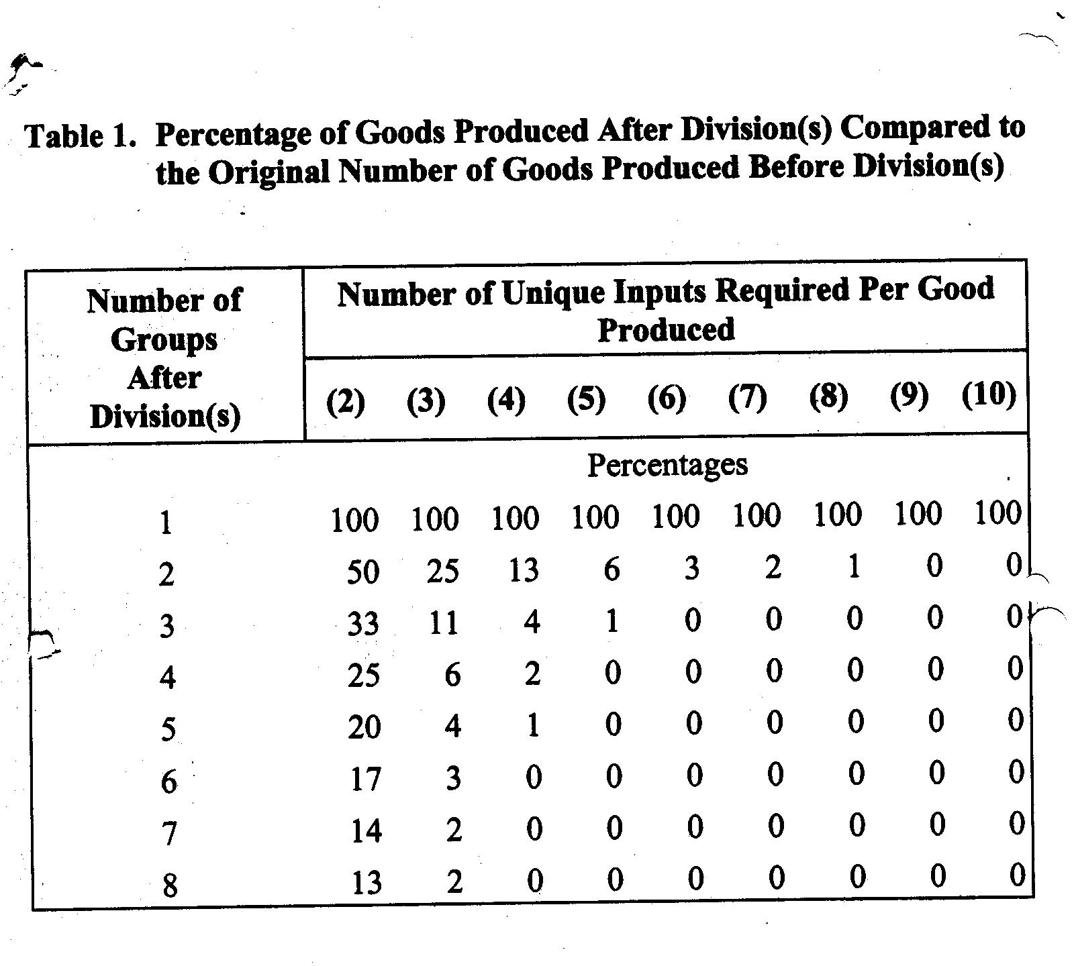

Slide 59
Implication of social capital paradigm: the appeal of goods and services depends on the needs they satisfy.

Slide 60
Sample properties
Characteristics of sample and population | Sample averages (n=990) 2013 | US Census (population) 2015
Average age | 35.08 | 49.01
Median household income | $40,000 to $50,000 | $53.482
White (2015) | 79.9% | 77.1%
African American | 6.3% | 13.3%
Asian | 4.7% | 5.6%
Hispanic | 5.7% | 17.6
2 or more races | .6% | 2.6%
Ed. Hs + | 99.7% | 86.3%
Over 65 | 2.2% | 14.9
Gender (% female) | 51.3 | 50.8

Slide 61
The average motive scores for 990 subjects when buying gasoline, buying a haircut, recycling, and voting.
Motive |  | Mean | Standard Error | t-statistic | p-value
Gas Purchase
Own consumption |  | 87% | 2.43 | 35.8 | 0.000
Good will |  | 1% | 0.53 | 1.89 | 0.029
Self-respect |  | 4%% | 1.05 | 3.81 | 0.000
Belonging |  | 2% | 0.95 | 2.11 | 0.017
Sharing |  | 6% | 1.48 | 4.05 | 0.000

Slide 62
Table 4. The average motive scores for 990 subjects when buying gasoline, buying a haircut, recycling, and voting.
Motive |  | Mean | Standard Error | t-statistic | p-value
Haircut
Own consumption |  | 47% | 4.21 | 11.16 | 0.000
Good will |  | 1% | 0.63 | 1.59 | 0.056
Self-respect |  | 29% | 3.48 | 8.33 | 0.000
Belonging |  | 2% | 0.84 | 2.41 | 0.008
Sharing |  | 21% | 3.16 | 6.65 | 0.000

Slide 63
Table 4. The average motive scores for 990 subjects when buying gasoline, buying a haircut, recycling, and voting.
Motive |  | Mean | Standard Error | t-statistic | p-value
Recycling
Own consumption |  | 17% | 3.06 | 5.56 | 0.000
Good will |  | 5% | 1.58 | 3.16 | 0.000
Self-respect |  | 34% | 3.06 | 11.11 | 0.000
Belonging |  | 11% | 1.79 | 6.15 | 0.000
Sharing |  | 34% | 3.06 | 11.11 | 0.000

Slide 64
Table 4. The average motive scores for 990 subjects when buying gasoline, buying a haircut, recycling, and voting.
Motive |  | Mean | Standard Error | t-statistic | p-value
Voting
Own consumption |  | 13% | 2.32 | 5.6 | 0.000
Good will |  | 2% | 1.05 | 1.9 | 0.029
Self-respect |  | 23% | 2.74 | 8.39 | 0.000
Belonging |  | 18% | 2.53 | 7.11 | 0.000
Sharing |  | 44% | 3.48 | 12.64 | 0.000

Slide 65
Summary of empirical results varying type of goods in exchanges
Own consumption motive dominates when exchanging commodities (gasoline)
Own consumption and social capital motives are both important when exchanging commodities for a mixed good (haircut).
Social capital motives dominate when exchanging commodities for relational goods (recycling and voting).

Slide 66
Do motives change depending on one relationship with his/her exchange partner?
With someone you dislike?
With a stranger?
With a friend?
With a family member?

Slide 67
Tle 1. The average motive scores for 52 subjects when asked about the relative importance of motives when selling their used car with a market value of $3,000 to a nasty neighbor, a stranger, a friend, and an impoverished family member.
Motive |  | Mean
Nasty neighbor (average min. sell. price $3,213; range $2,200-$5,000)
Own consumption |  | 74%
Good will |  | 3%
Self-respect |  | 18%
Belonging |  | 3%
Sharing |  | 2%
Stranger (average min. sell price $2,860; range $2,500-$4,000)
Own consumption |  | 54%
Good will |  | 3%
Self-respect |  | 33%
Belonging |  | 2%
Sharing |  | 8%

Slide 68
The average motive scores for 52 subjects when asked about the relative importance of motives when selling their used car with a market value of $3,000 to a nasty neighbor, a stranger, a friend, and an impoverished family member.
Motive |  | Mean | Standard Error | t-statistic | p-value
Friend (average min. sell price $2,347; range $1,000-$3,000)
Own consumption |  | 20%
Good will |  | 5%
Self-respect |  | 23%
Belonging |  | 13%
Sharing |  | 39%
Poor family member( average min. sell price $1,605; range $0-$3,000)
Own consumption |  | 12%
Good will |  | 5%
Self-respect |  | 26%
Belonging |  | 11%
Sharing |  | 46%

Slide 69
Table. The average motive scores for 52 subjects when asked about the relative importance of motives when selling their used car with a market value of $3,000 to a nasty neighbor, a stranger, a friend, and an impoverished family member.
Relationship | Mean | SE | t¹ | p
Nasty Neighbor | $3,212.50 | 77.538 | 2.741 | 0.008*
Stranger | $2,859.62 | 35.25 | -3.983 | 0.000**
Friend | $2,347.12 | 63.019 | -10.36 | 0.000**
Poor family member | $1,604.83 | 122.933 | -11.349 | 0.000**
Note 1: testing for μ-$3000
* p<.01, ** p<.001

Slide 70
Summary of motives and exchanges of commodities with varying levels of social capital
Own consumption motives dominate when exchanging commodities with someone you don’t like or a stranger.
Social capital motives dominate when exchanging commodities with a friend or family member.
When exchanging commodities with a stranger, results are consistent with the standard economic model

Slide 71
Limitations and concerns?
Self-declared motives—are they stable?
Are survey questions consistent with motives?
Could these results be obtained from a hedonic model where relationships is a pairwise characteristic?
Are there fixed effect?
Do characteristics of survey respondents matter (age, income, gender, ethnicity)
Endogeneity?

Slide 72
Therefore—what?

Slide 73
Mixed exchanges may produce a more balanced distribution of commodities
Mixed exchanges permit those rich in commodities to exchange with those whose only goods are relational and improve both parties to the exchange (infants, elderly, disadvantaged)

Slide 74
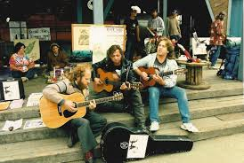
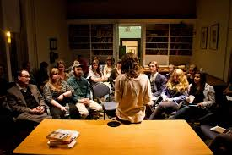
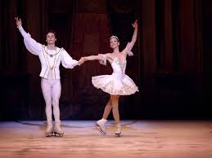
Mixed exchanges create a forum for persons to exchange their relational goods for commodities. Examples of persons engaged in such exchanges include poets, authors, actors, athletes, artists, musicians, lecturers, teachers. Because these can participate in mixed exchanges—they can survive in a commodity exchange world..

Slide 75
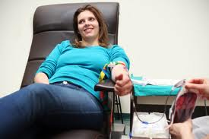
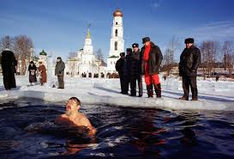
Relational good rewards provide incentives to do things we would never otherwise do

Slide 76
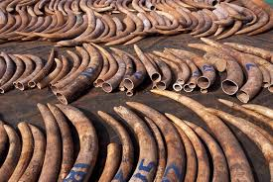
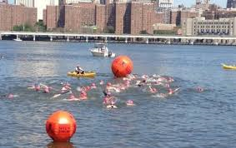
We internalize the condition of decommodified goods and act to preserve them. Relational good rewards (costs) motivate us to “not” engage in some commodity exchanges even though there is a profit to be made. As a result, within social capital rich networks, common properties are not exploited, investments are made in public goods,
.

Slide 77
Some transactions take place that otherwise would not have occurred when relational goods are included in benefits of an exchange.

Slide 78
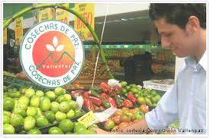
New ways of creating value may lessen our natural footprint on a world with limited physical goods and services.

Slide 79
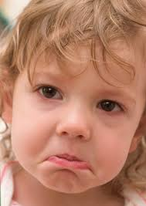
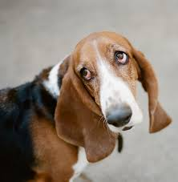
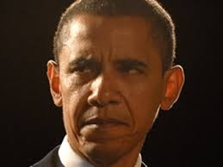
Some disadvantages created by including Relational goods in exchanges

Slide 80
Informal institutions may replace formal institutions (corruption)

Slide 81
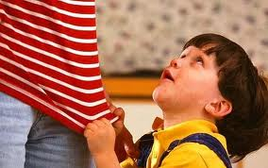
Can be used to exploit those providing social capital: (e.g. spoiled children and rich relatives)

Slide 82
Sometimes corruption can be a good thing used to circumvent impossible formal institutions
Sometimes corruption can be a good thing used to circumvent impossible formal institutions
Most of the time corruption increases transaction costs and reduces specialization and trade
Leads to unequal income distribution and reduces attachment value for formal institutions.

Slide 83
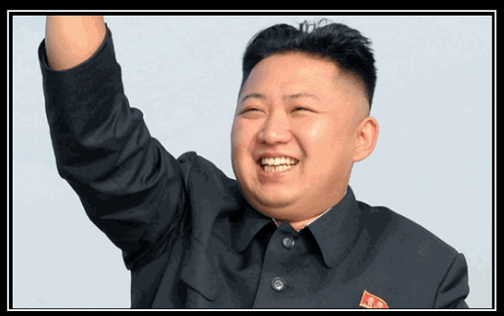
Relational goods produced by Cheap social capital is the favorite resource for all despots.
Cheap social capital is created by finding someone we can all agree to hate..

Slide 84
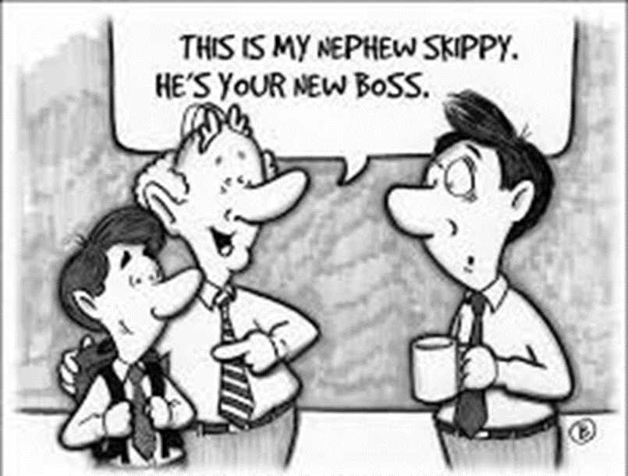
Social capital can lead to exchanges that produce inefficiencies in the production of commodities.
.

Slide 85
Attachment values may delay efficient changes (sunk costs aren’t really sunk costs when they have attachment value.)

Slide 86
Attempts to purchase relational goods may convert relational goods into commodities. (Some relational goods should not be exchanged for money.)
.

Slide 87
Examples of relational good/commodity Exchanges that cause ethical concerns(Sandel)
a prison cell upgrade,
someone to apologize for you behaving badly,
the services of an Indian surrogate mother,
the right to exceed the posted speed limit,
the right to tattoo a casino ad on the forehead of a single mother,
the privilege of immigrating into the United States,
admission to a prestigious university,
a ticket to a congressional hearing,
concierge health care,
human lab rats for drug trials—payment increases with the riskiness of the drug,
Blood and human organs,
the right to pollute
children who read
prestigious ambassadorships which can be exchanged for sizable campaign contributions
and one’s soul—for fifty dollars

Slide 88
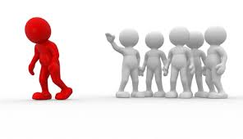
Some networks that exchange relational goods may lead to the exclusion of those outside the network.

Slide 89
The end! Questions?

